Slide 1
Cyclones in Australia
Analysis Of Cyclones Since 1990
Project 3
Team Members:
Ezra Tassone & Stephen Milton

Slide 2
Overview
An analysis of Australian cyclone data since 1990 (from BOM)
Numerous cyclones since 1990 and we as a team wanted to analyze the data to identify any existing trends
Original data set had information since 1907 but chose to focus on data for last 30 years
Consulted a Physical Oceanographer who in turn helped us understand the data and parameters within the data set
As the subject was new to the team, we had to study the data set documentation in depth to understand the data collected and its importance prior to our machine learning

Slide 3
Questions to Answer
What were the Top 10 cyclones ranked by Central Pressure since 1990?
What were the significant metrics for cyclones over their duration?
Are there a correlation between and maximum wind speed?
Can we predict the wind direction of cyclones with machine learning?
Is there any other cyclone metrics that can be modeled?

Slide 4
Data Wrangling
Clean and modify the data using Pandas and Jupyter Notebook.
Use HTML, CSS and JavaScript on the front end.
Use D3, Plotly, JSuites and Leaflet to visualize the data.
Use Python as the programming language, Flask as the web server and Heroku to host the application
Deployed Python’s Scikit machine learning models

Slide 5
Website Demo
https://et-cyclonesau.herokuapp.com

Slide 6
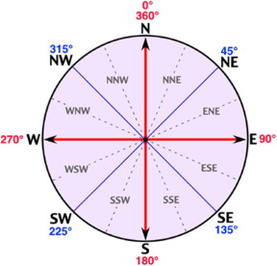
Machine learning
Which feature to choose as the “Y” or dependent variable?
Suggested to choose the “Max Wind Direction” measured from 0⁰ to 360⁰
We had to group these into 8 compass points covering a range of degrees

Slide 7
Machine learning
There were 79 features in the raw data set
Removed all features with ‘null’ and ‘0’ values
This reduced the data set significantly to 6 features for ml model
SURFACE_CODE - Indicates the type of surface (land /water)
CYC_TYPE – Type of cyclone e.g. Tropical/Sub Tropical/Over Land etc..
LAT – Latitude of Cyclone Centre
LON – Longitude of Cyclone Centre
CENTRAL_PRES - Central pressure of the cyclone (hPa)
MAX_WIND_SPD - Estimated maximum mean wind around the cyclone (m/s)
Added 2 derived features called:
CENTRAL INDEX – (0.186*V₆₀)^{0.746} (Where V₆₀ (one-minute sustained winds) derived from CP)
WAVE HEIGHT – V₆₀ * 0.235

Slide 8
Machine learning
Experimented with 3 Models
Support Vector Machine
K Nearest Neighbour
Random Forest
Used all eight features in models
The data set had 1679 observations to train and test

Slide 9
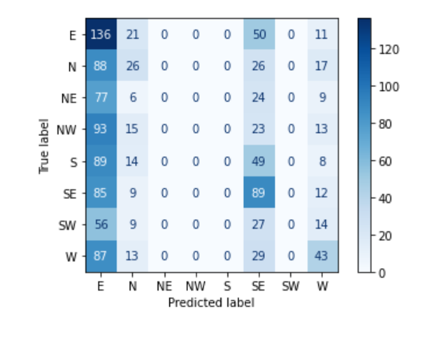
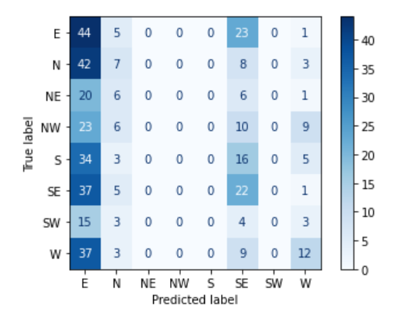
Machine learning
Support Vector Machine
Scaled data using Standard Scaler
Training Score Accuracy – 23.2%
Test Score Accuracy – 20.1%
Training Classification Test Classification

Slide 10
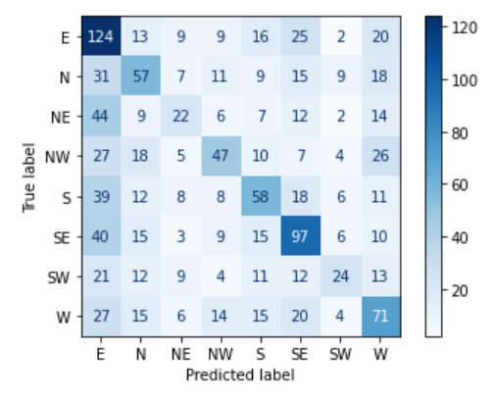
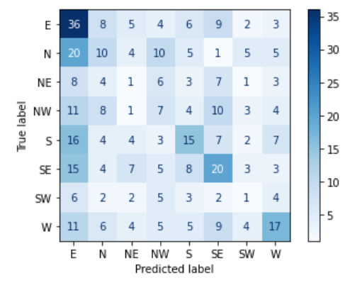
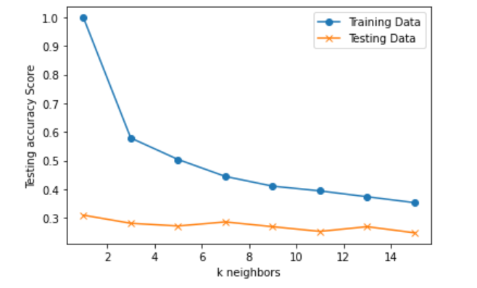
Machine learning
K Nearest Neighbour
Scaled data using Standard Scaler
K = 11
Training Score Accuracy - 39.4%
Test Score Accuracy - 25.3%
Training Classification Test Classification Plot of K Neighbours

Slide 11
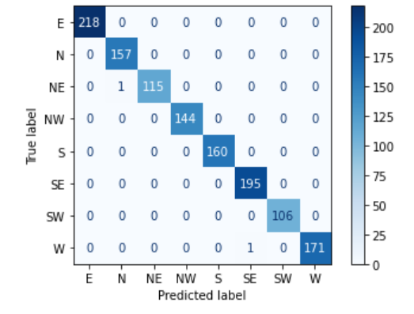
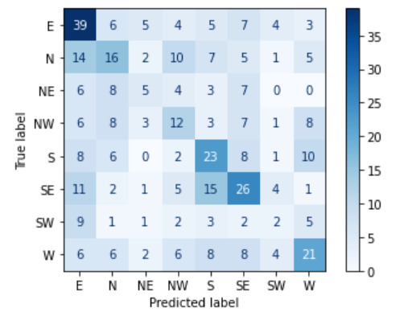
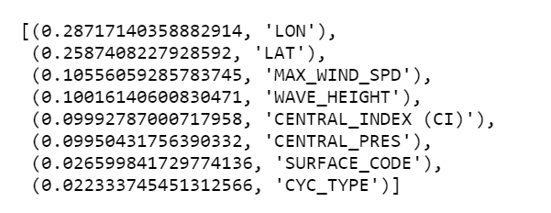
Machine learning
Random Forest
Scaled data using Standard Scaler
Feature importance was calculated ref pic below
Training Score Accuracy - 99.8%
Test Score Accuracy - 34.5%
Training Classification Test Classification Feature importance pic

Slide 12
Analysis of ML
Ranked in terms of classification accuracy:
Random Forest
KNN
SVM
No classifier is working well!
Lack of relevant features for classification
For wind direction prediction you need 3D data whereas the current data set is 1D
Need more input from domain experts

